Slide 1

Node JS

Slide 2
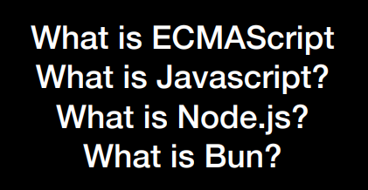
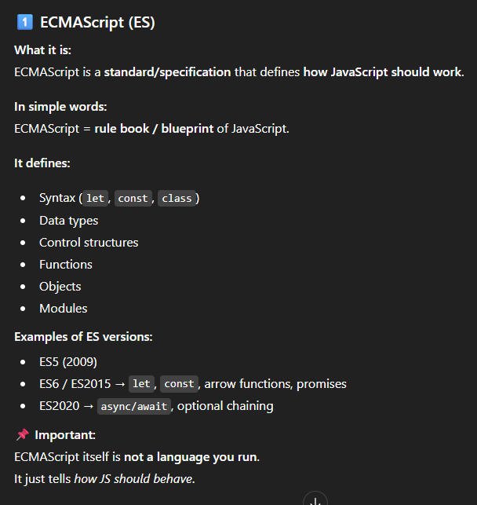
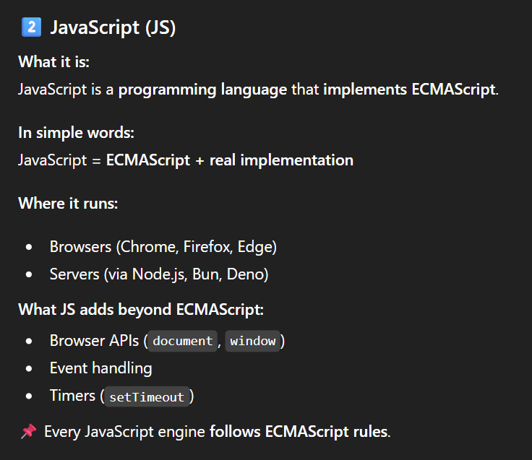

Slide 3
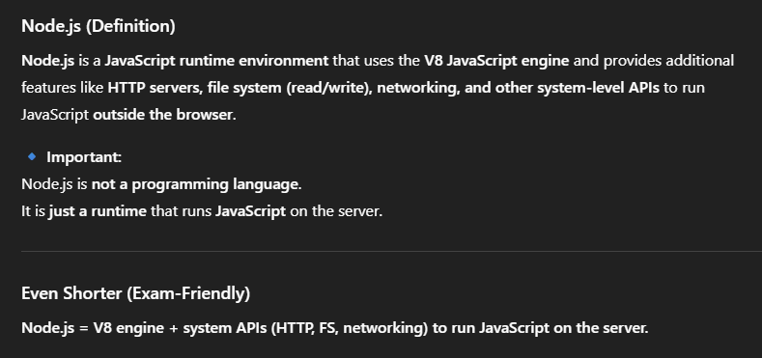
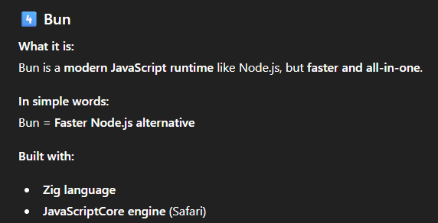
3️⃣

Slide 4

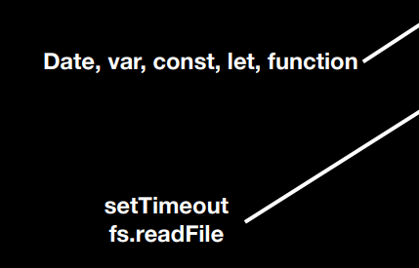

Slide 5
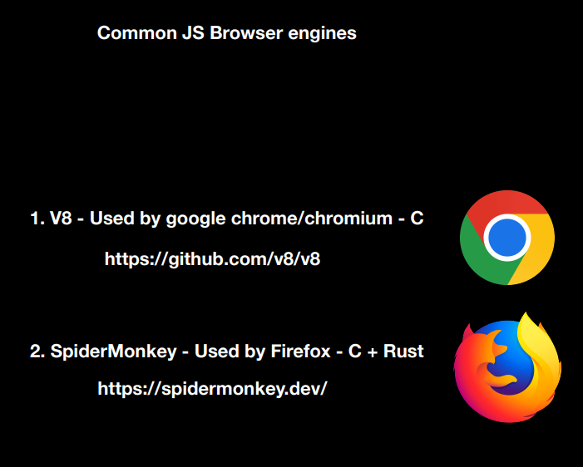

Slide 6


Node JS

Slide 7
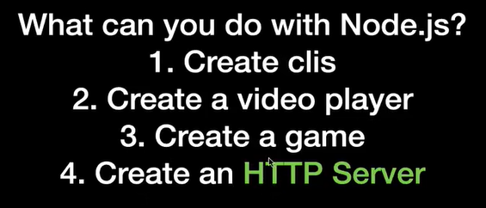
Note : Node JS is introduced for backend
Note : Here we use Node JS to create HTTP server

Slide 8
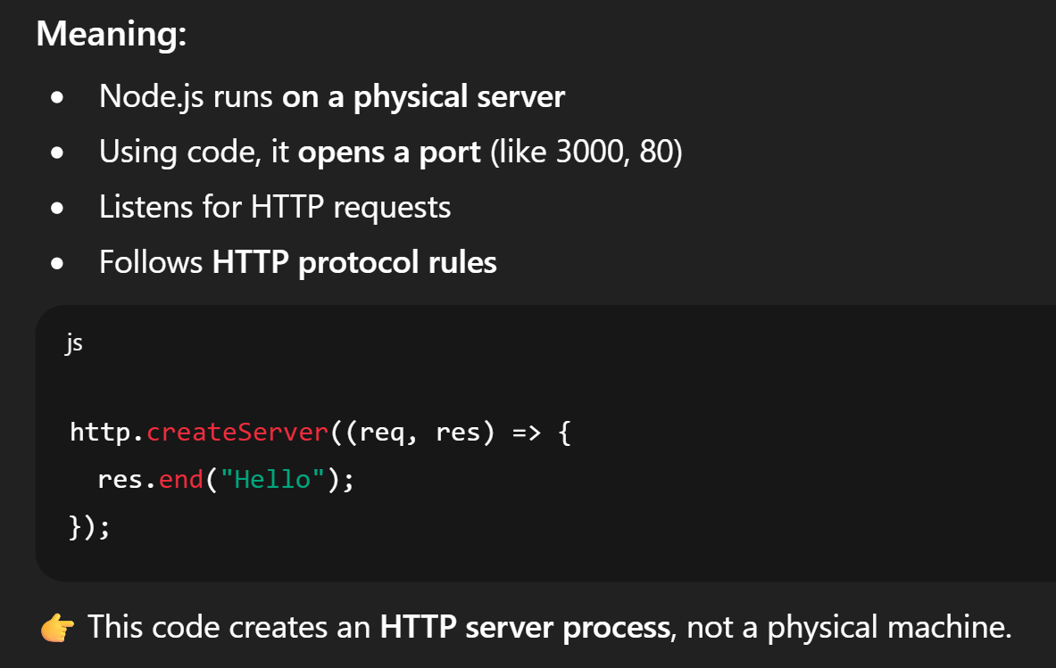
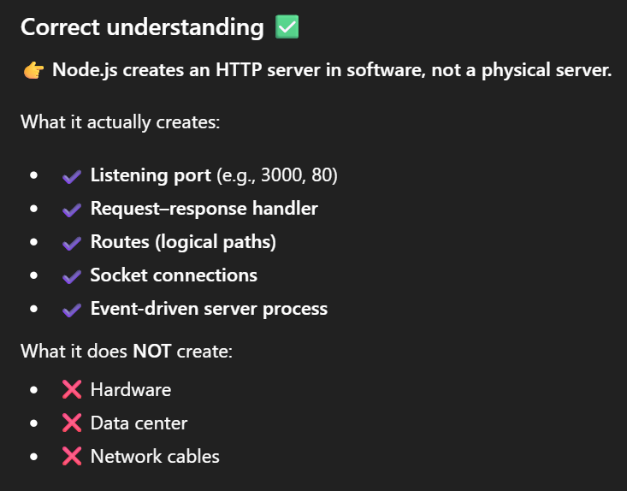
HTTP Server
Node.js creates HTTP servers (Not Physical Server) which follow HTTP Protocols.

Slide 9
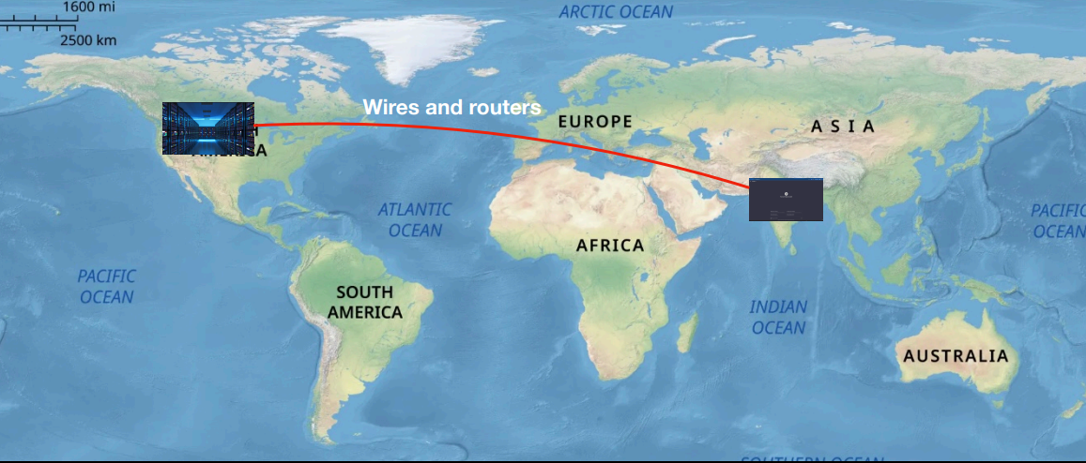
NOTE : The HTTP protocol is NOT a physical thing.
HTTP Server
HTTP Protocol

Slide 10
HTTP Protocol
A protocol that is defined for machines to communicate
Specifically for websites, it is the most common way for your website’s frontend to talk to its backend.

Slide 11
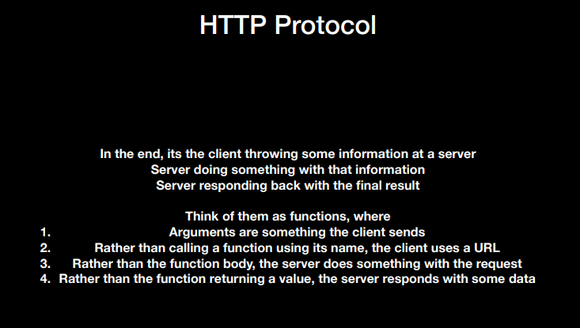

Slide 12
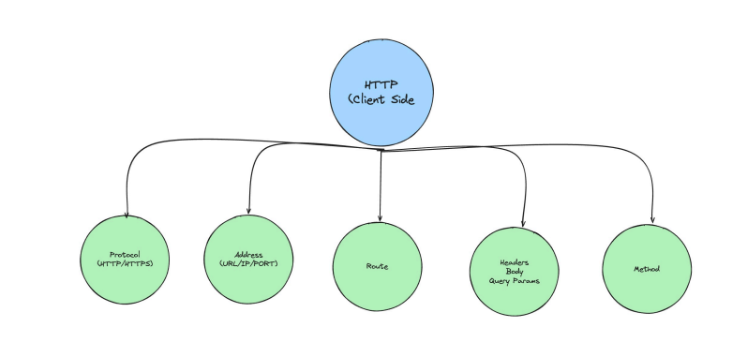
Things Client Sends

Slide 13
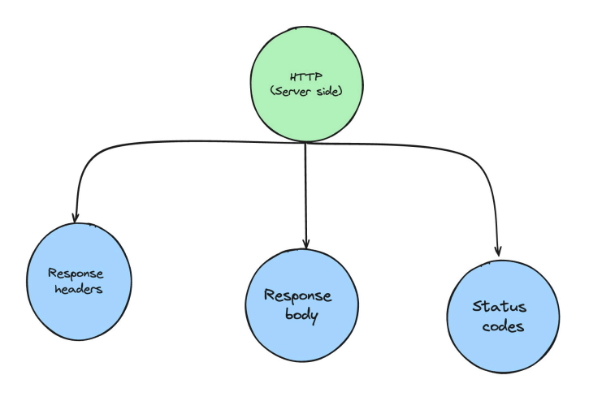
Things Server Sends

Slide 14
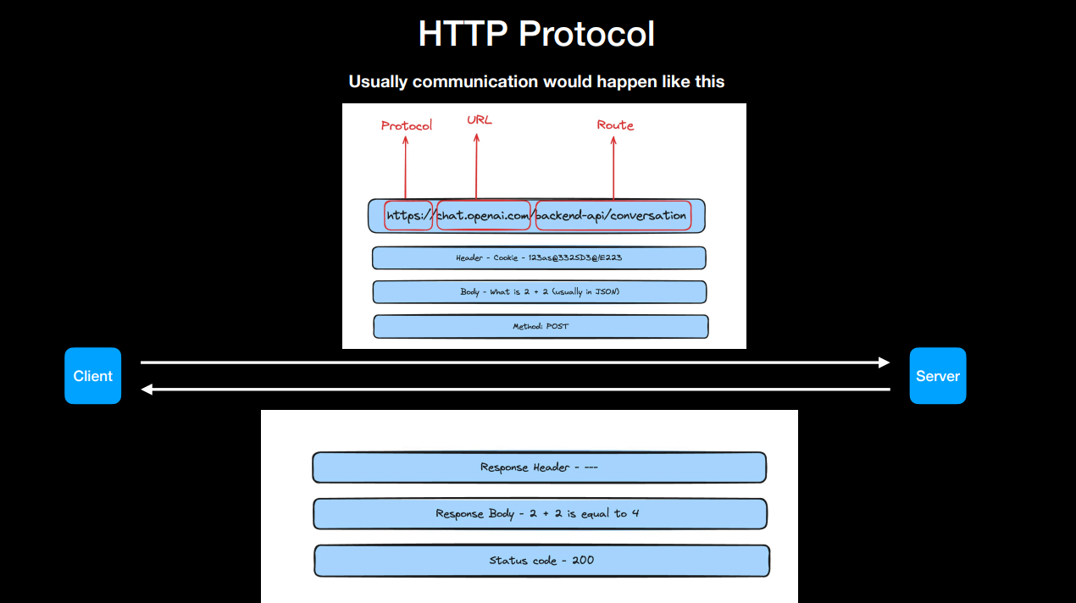
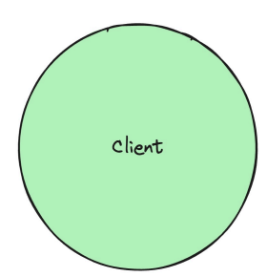
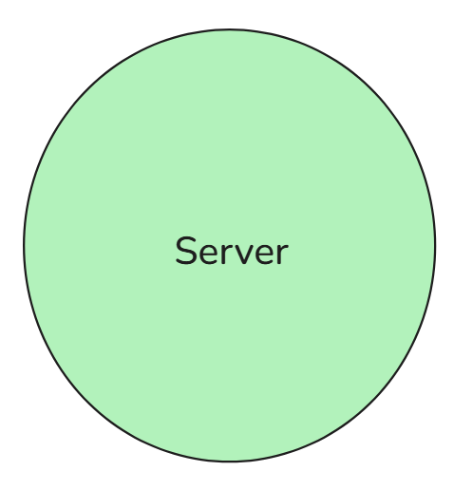

Slide 15
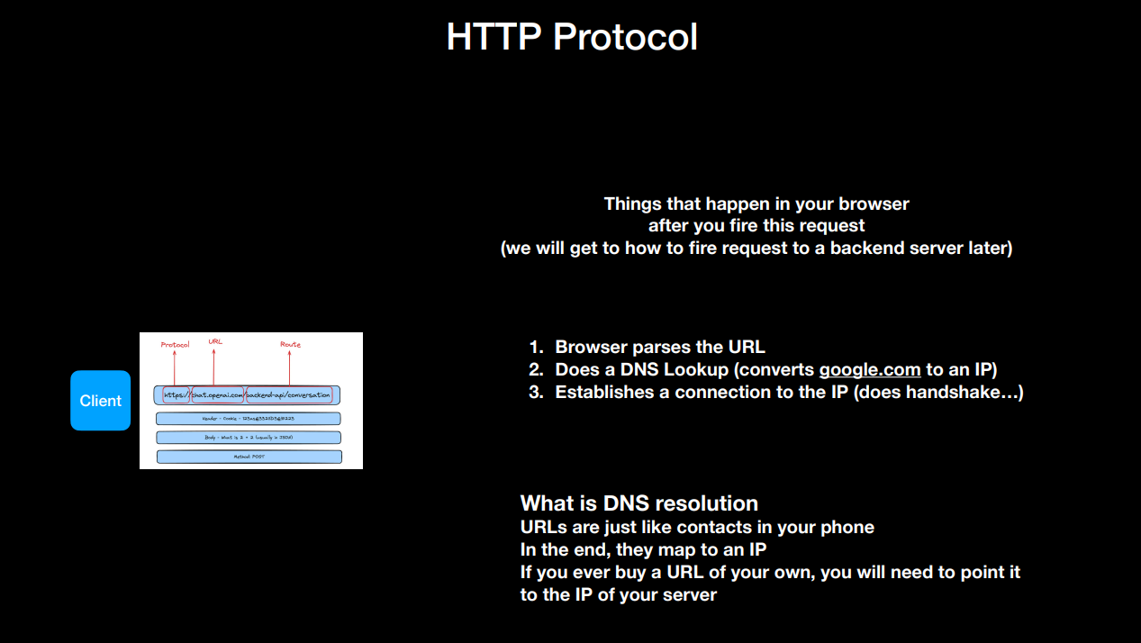

Slide 16

How to Create HTTP Server

Slide 17
Thank You

